Slide 1
Control Panel Review Answers
Anika Karpurapu

Slide 2
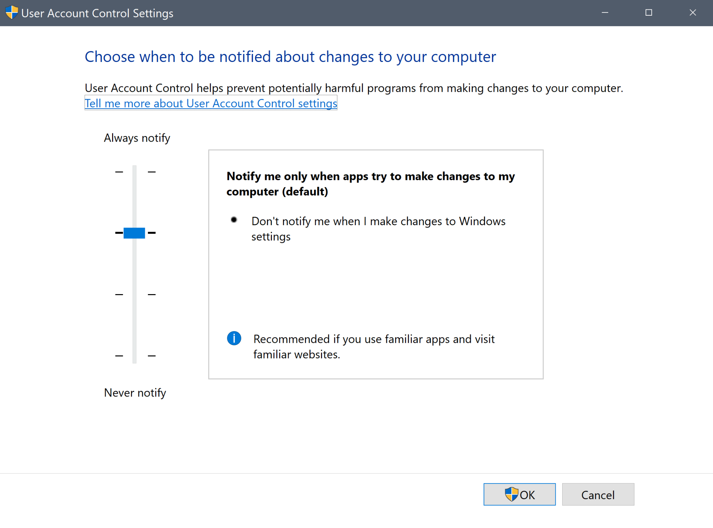
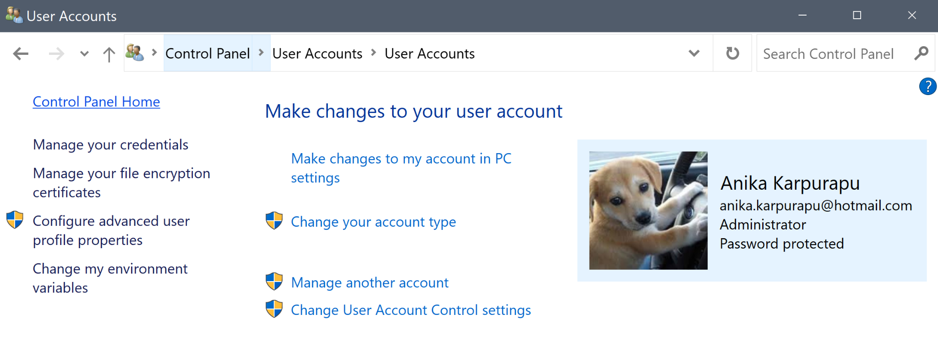
Han Solo is able to run apps with administrative privileges without being prompted for permission. How would you restrict Han Solo’s permissions so that he gets these prompts?
User Accounts → Change Account Control settings
Never notify - no notifications
Always notify - notifications every time

Slide 3
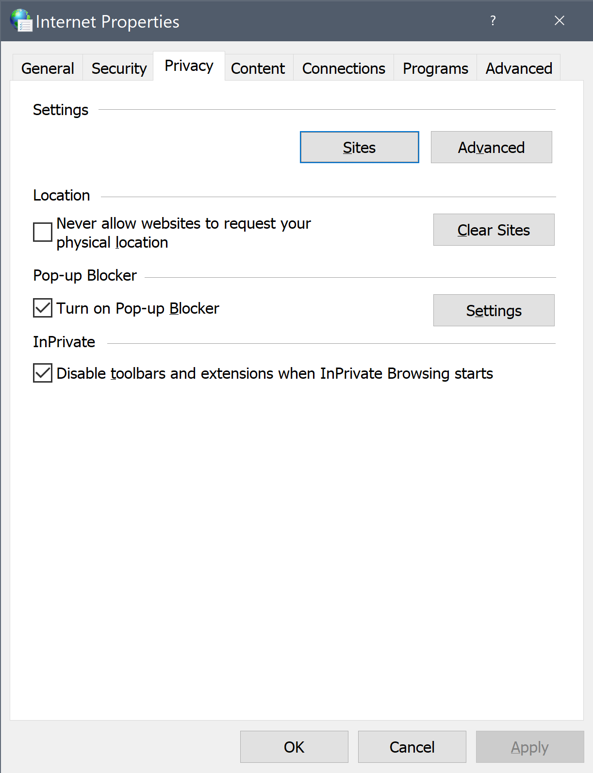
For some reason, Anakin Skywalker is getting frequent pop-ups and he doesn’t know how to get rid of them. What should he do?
Network and Internet → Internet Options → Privacy
Always turn on Pop-up Blocker

Slide 4
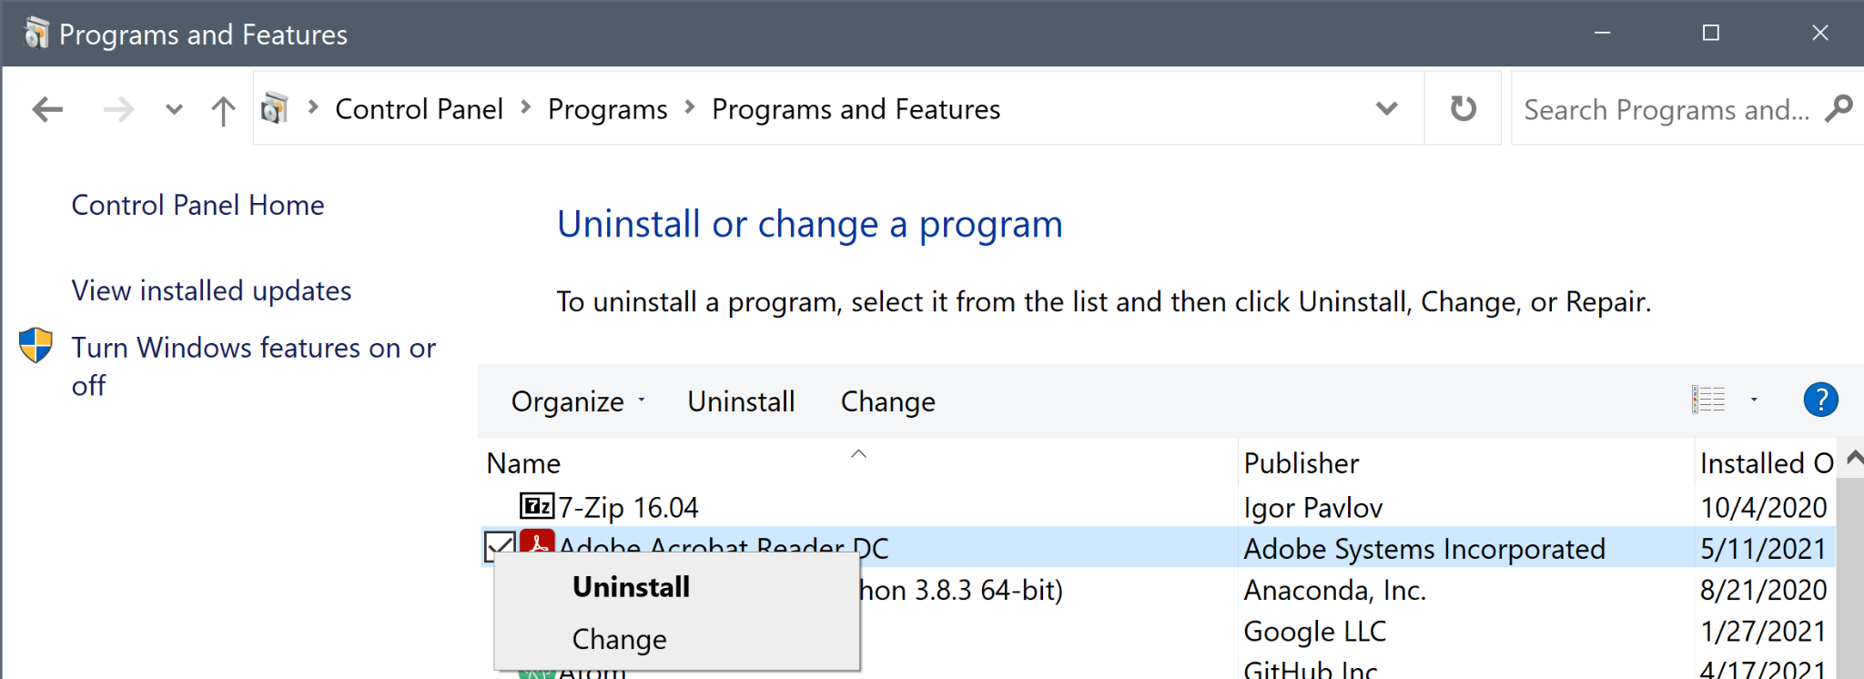
Leia just got a new laptop and found out that it has an insecure gaming platform downloaded. Can you tell her how to remove the game?
Programs → Programs and Features
Uninstall or change a program
Right click to uninstall

Slide 5
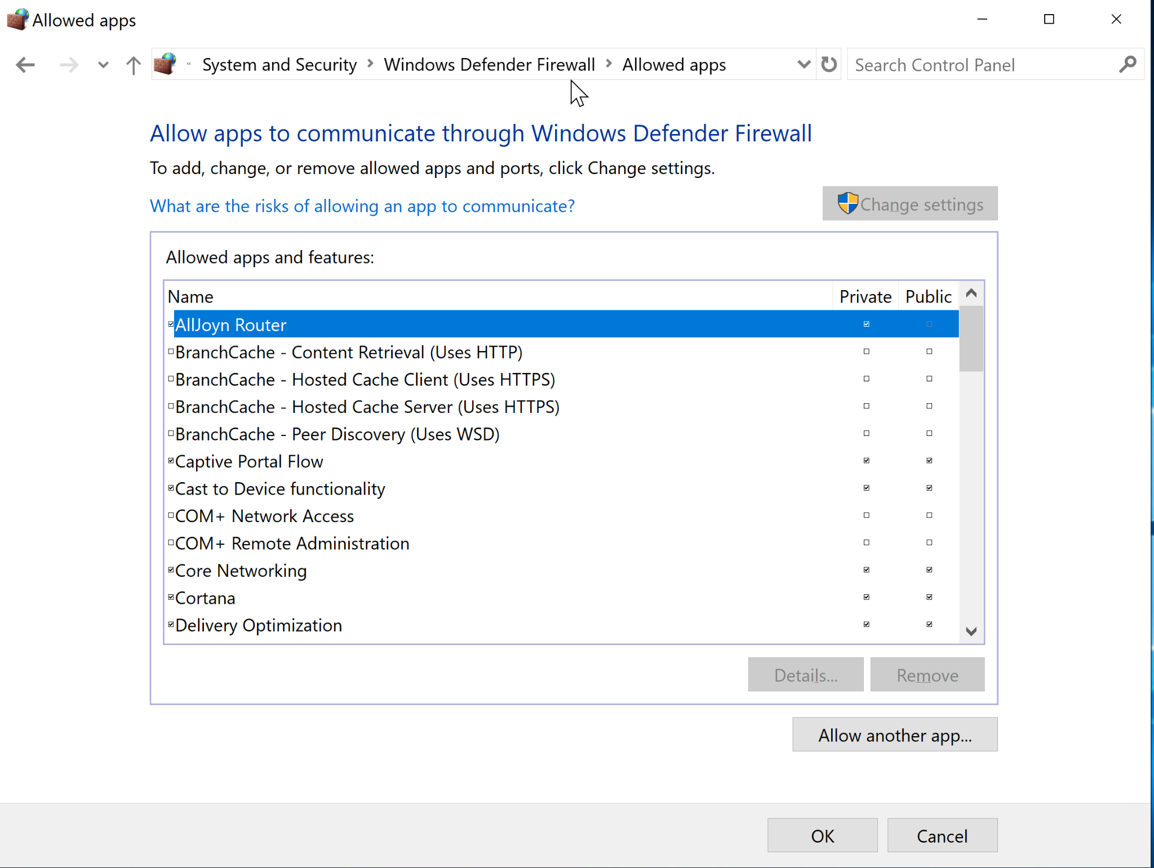
Now that Leia has a secure laptop, she wants to download an editing software that she always wanted to try. But, some settings on her laptop prevent her from using it due to a firewall error. What should she do?
System and Security → Windows Defender Firewall → Allowed Apps
Allow another app

Slide 6
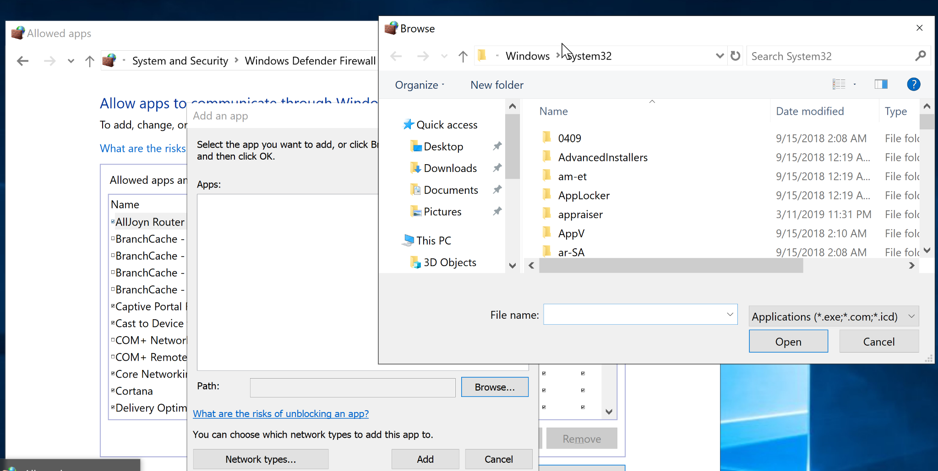

Slide 7
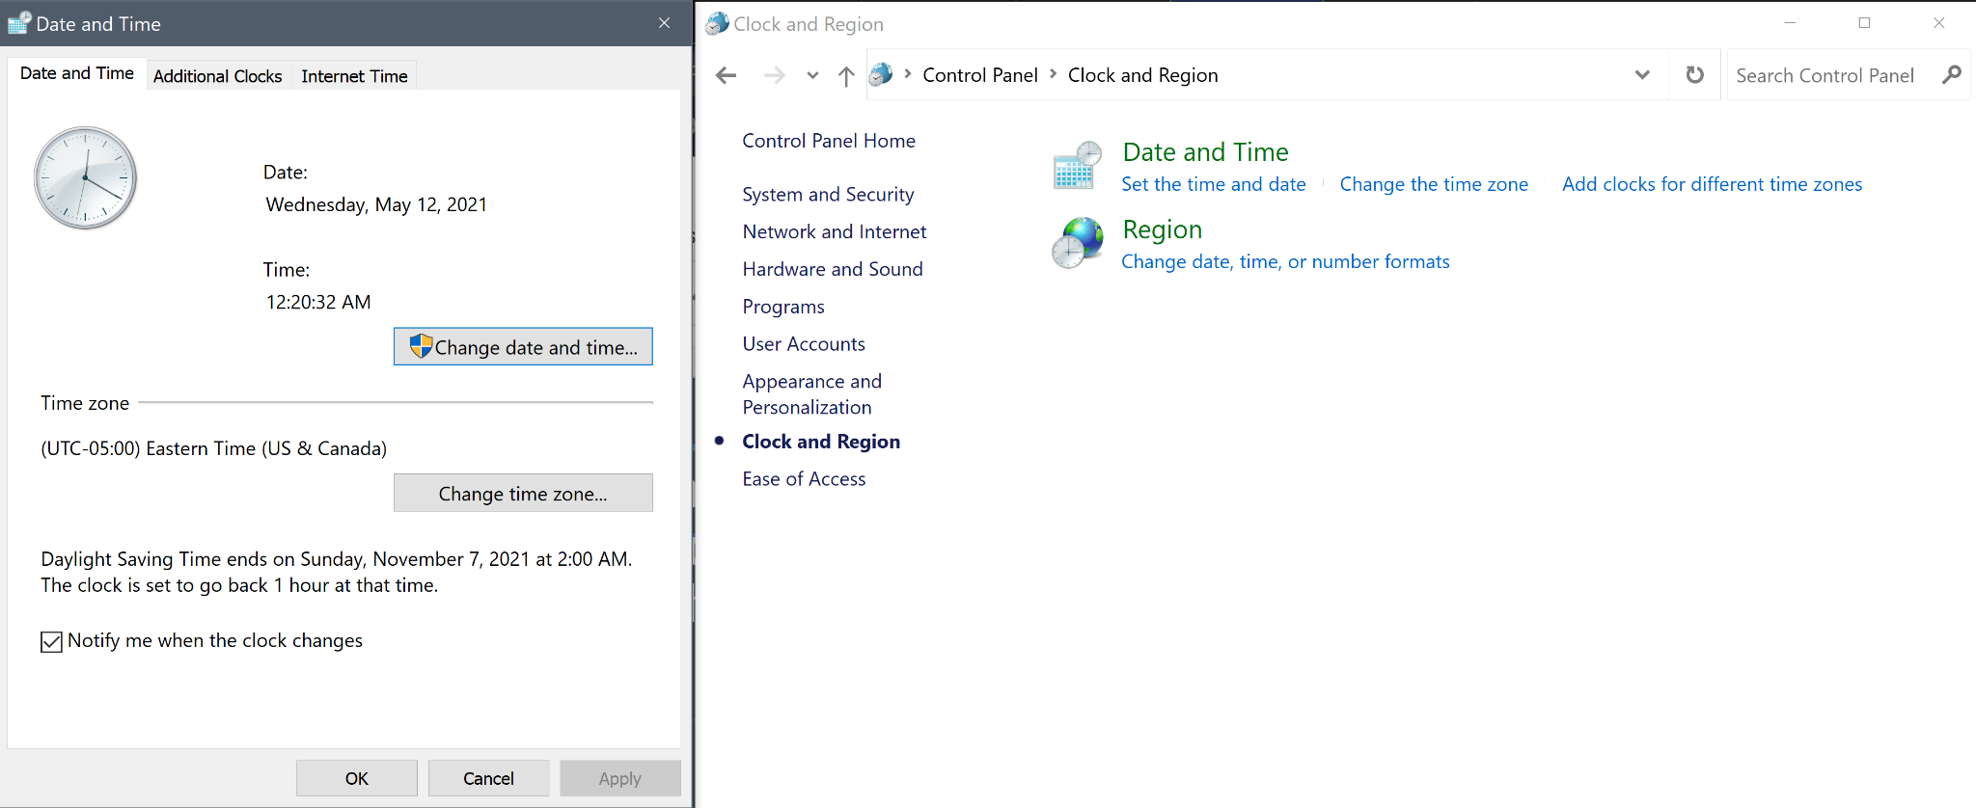
Luke is in a little dilemma and is scared to ask his friends to help. He has the wrong date and time settings on his laptop, and his employer said he would fire him if he didn’t fix it immediately. What setting does Luke need to change in order to keep his job?
Clock and Region →
Date and Time

Slide 8
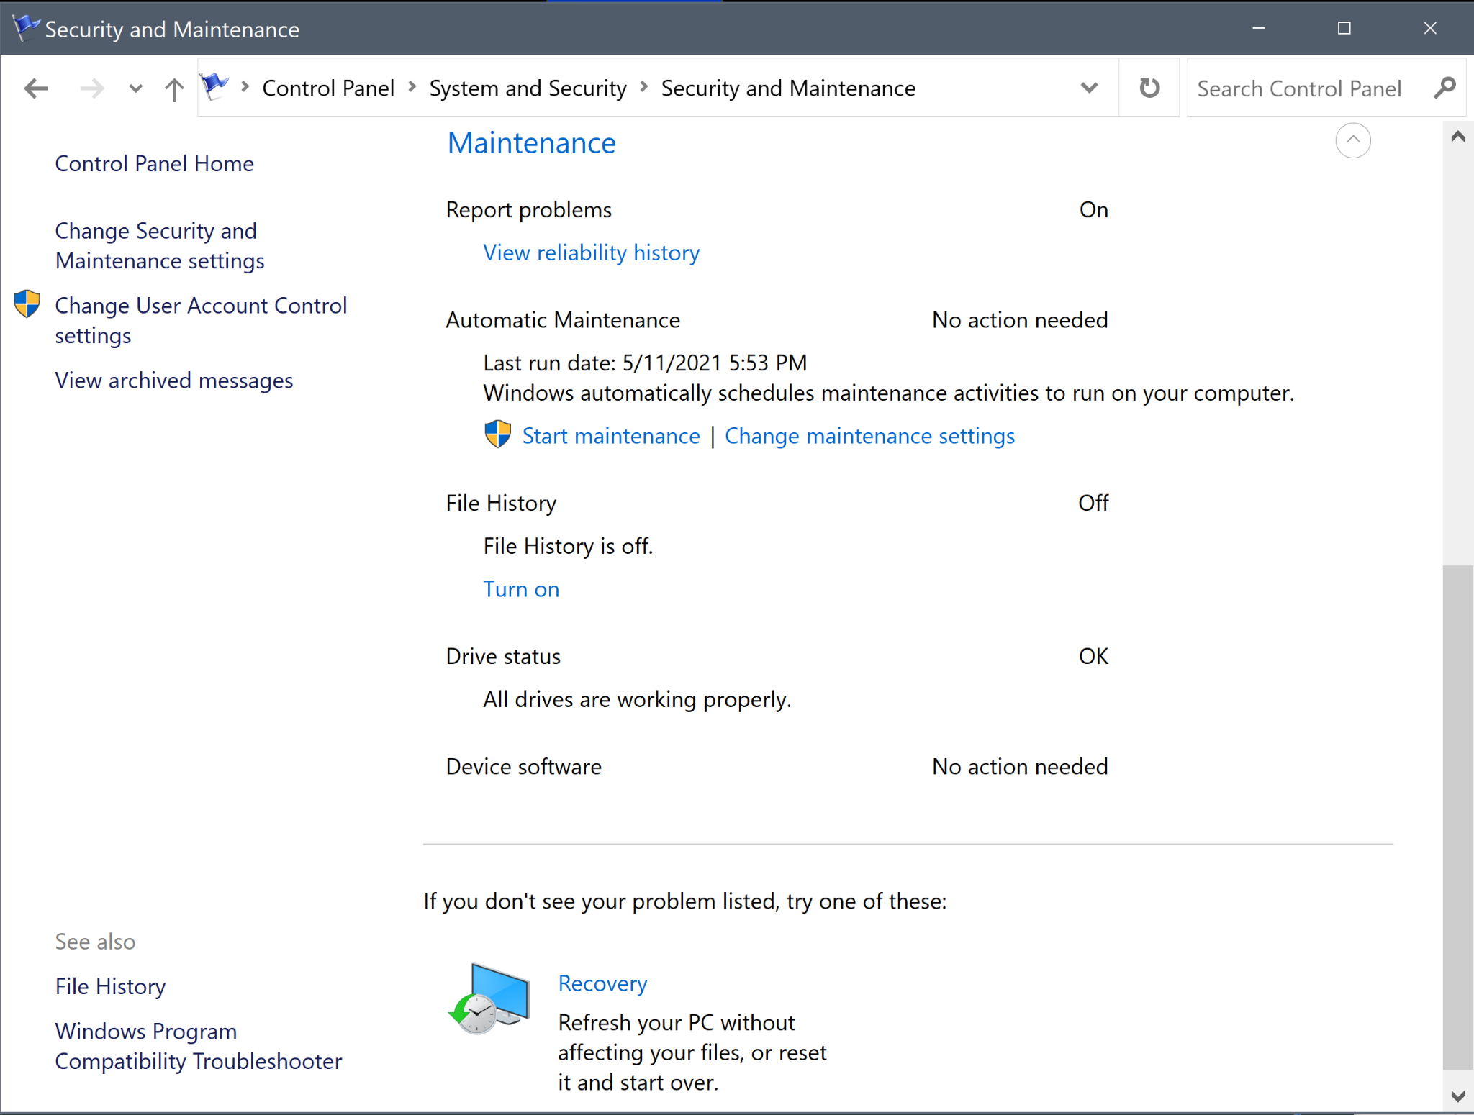
Jeff wants to change a setting to ensure that he never truly loses his files. How should he deal with file history maintenance?
System and Security → Security and Maintenance
Maintenance → File History
Periodically backs up files
Media
Documents
Similar to Windows Backup
BUT it doesn’t protect the system

Slide 9
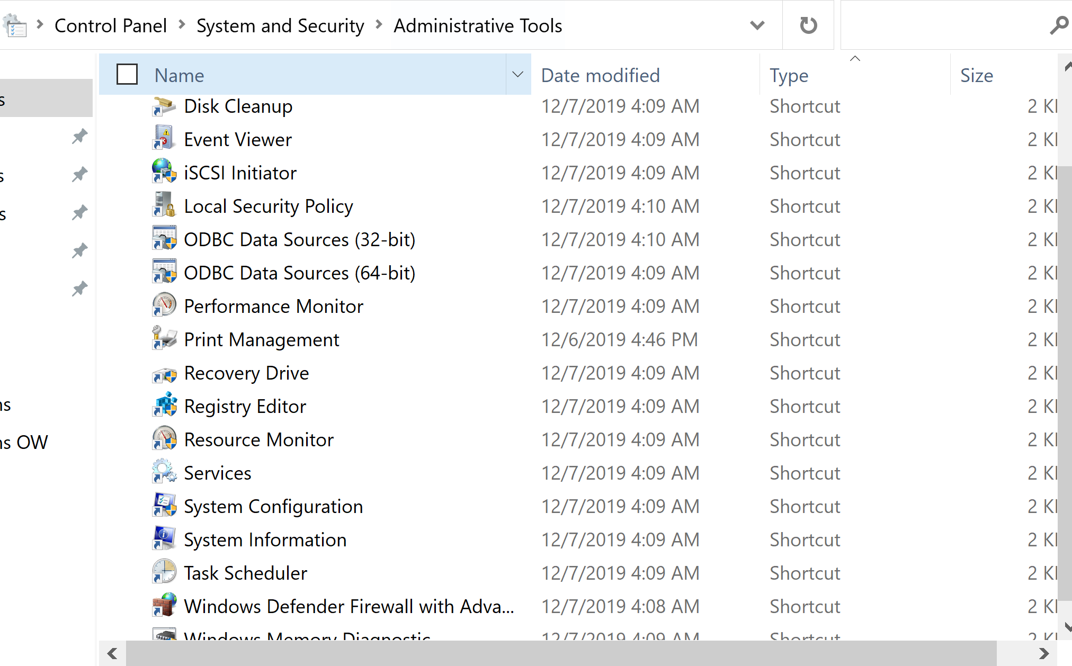
How would Madison access Local Security Policy through the control panel?
System and Security → Administrative Tools → Local Security Policy
Can also access:
Computer Management
Services
Task Scheduler
Windows Defender

Slide 10
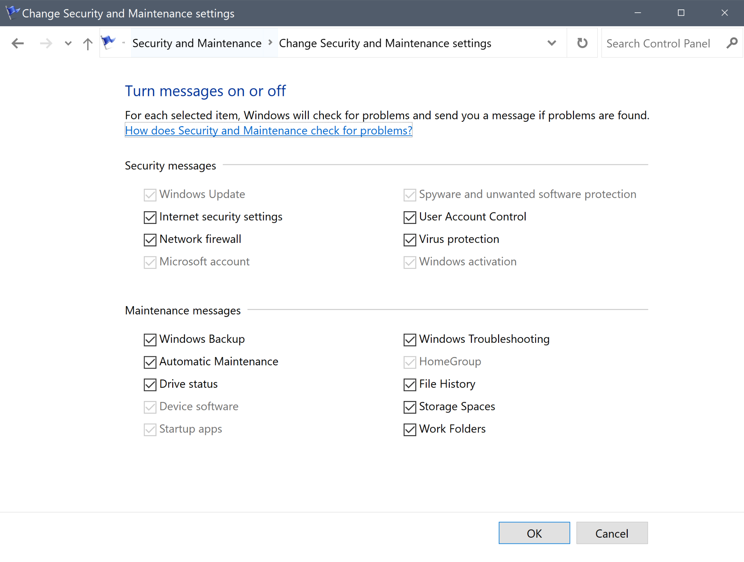
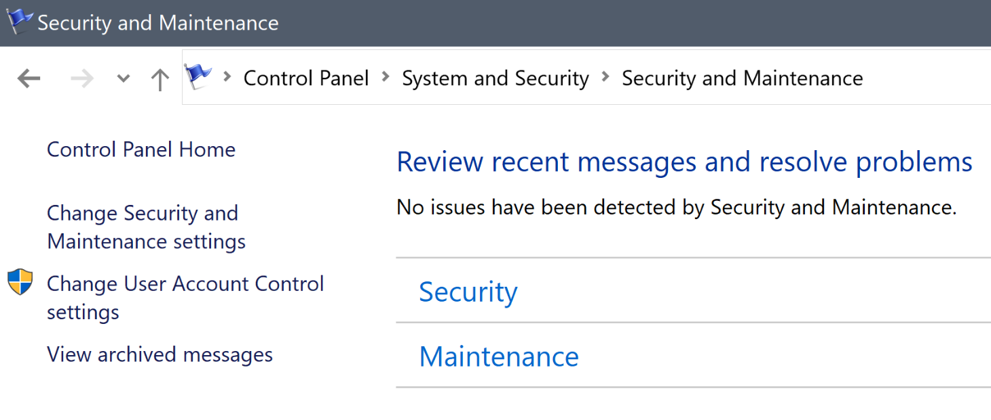
Janet does not get any messages/pop-ups whenever Windows finds bugs in her programs. What settings does she need to change to fix this?
System and Security → Security and Maintenance
Security and Maintenance Settings

